Slide 1
Lecture 03: Functions, interpolation, integration, differentiation
Sergei V. Kalinin

Slide 2
Reminder
All homeworks, midterms, and finals will be Colabs
You will have a week for each
Late submissions are generally not a problem, but avoid accumulation
Semester deadlines are final
Don’t hesitate to ask for help and additional explanations!

Slide 3
This and that
Any comments re first homework?
Final project parameters:
Can be alternative to the final
Should meaningfully use optimization, Gaussian processes, or causal methods
Be connected to your own research
Ideally will become publication
Some possibilities:
Explore molecular space towards candidates with specific functionality
Building workflow for materials optimization in automated synthesis
Causal analysis of the perovskite data base
….

Slide 4
Functions and spaces
Our biggest strength – and weakness – is the intuition developed for the 3D Euclidean spaces
Mathematicians has created large set of alternative spaces based on possible functional relationships and properties of objects
All real number
All integral numbers
All functions over unit interval
… and many more
In physical sciences, only a small subset of these is practically useful
… but these general principles are important to know!

Slide 5
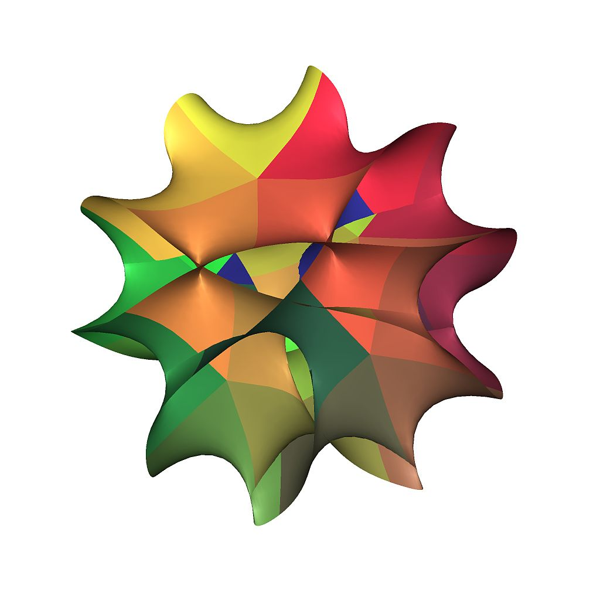
What is space?
A space is a set with some added structure. It consists of selected mathematical objects that are treated as points, and selected relationships between these points.
The nature of the points can vary:
elements of a set,
functions on another space, or
subspaces of another space.
The relationships between objects define the nature of the space.
Isomorphic spaces are considered identical, where an isomorphism between two spaces is a one-to-one correspondence between their points that preserves the relationships.
https://en.wikipedia.org/wiki/Space_(mathematics)
https://en.wikipedia.org/wiki/Calabi%E2%80%93Yau_manifold

Slide 6
What is function?
In mathematics, a function from a set X to a set Y assigns to each element of X exactly one element of Y. The set X is called the domain of the function, and the set Y is called the codomain of the function.
We can define function by:
Listing values
Algebraic formulae
Specified algorithm.
… and so on
Some function definitions:
f is injective (or one-to-one) if f(a) ≠ f(b) for any two different elements a and b of X
f is surjective if its range X equals its codomain Y , i.e. for each element y of the codomain, there exists some element x of the domain such that f(x)=y
f is bijective (or a one-to-one correspondence) if it is both injective and surjective. That is, f is bijective if, for any y ∈ Y, the preimage f⁻¹(y) contains exactly one element.
https://en.wikipedia.org/wiki/Function_(mathematics)

Slide 7
What should we look at practically?
These are important:
Dimensionality
Metrics (Distance Function)
Continuity and Differentiability
These may be important:
Symmetry
Topological Properties
Inner Product (Hilbert Spaces)
Manifold Structure

Slide 8
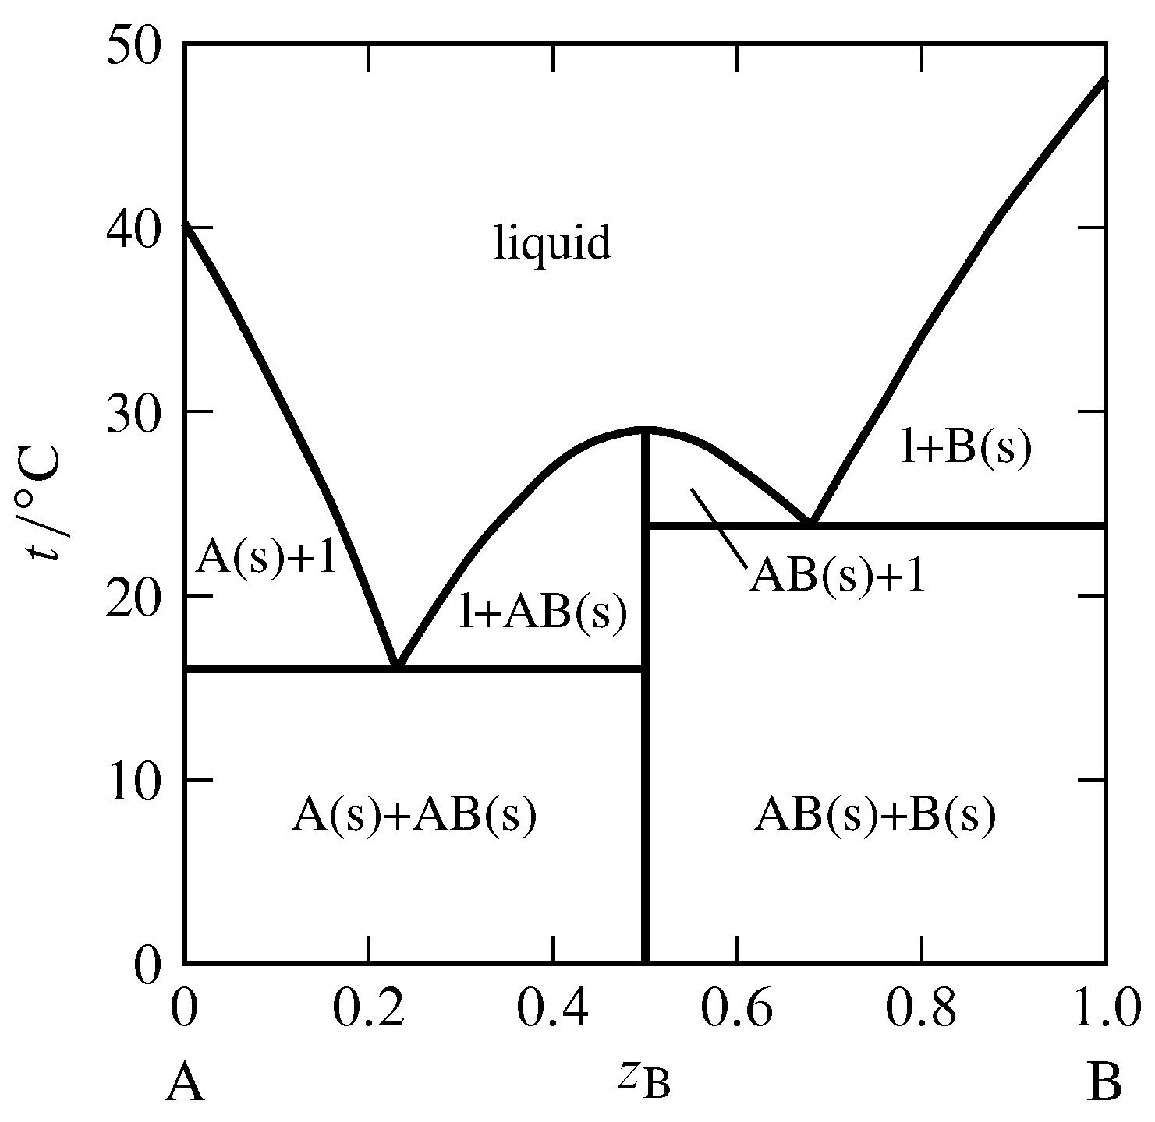
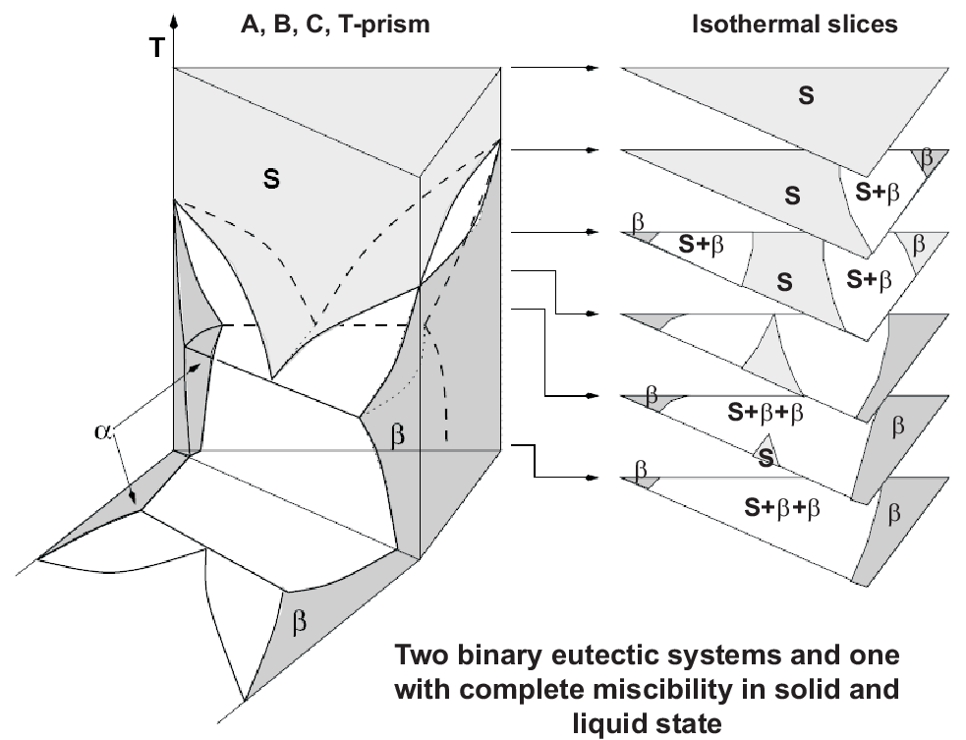
Phase diagrams
What is the dimensionality of the parameter space?
Is it differentiable?
What is the function?
Is it continuous?
Is it differentiable
13.2: Phase Diagrams- Binary Systems - Chemistry LibreTexts
https://www.tf.uni-kiel.de/matwis/amat/td_kin_ii/kap_1/backbone/r_se17.html

Slide 9

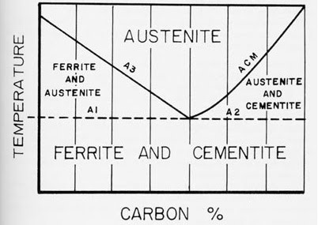
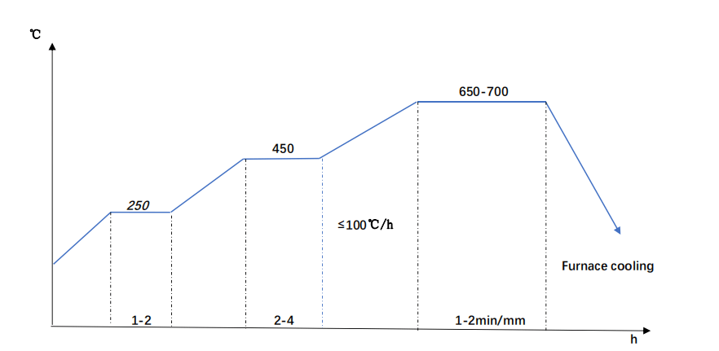
Processing

Slide 10
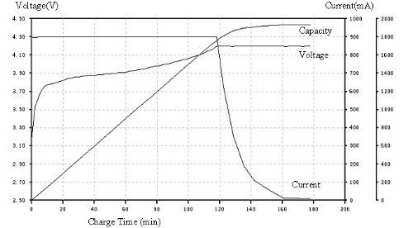
Processing
Making steel – can be complicated and took a lot of time optimize
Battery charging – fairly simple now, but obvious economic impact
Annealing hybrid perovskite thin films
Poling ferroelectric materials
… and so on
What is the dimensionality of the parameter space?
Is it differentiable?
What is the function?
Is it continuous?
Is it differentiable

Slide 11
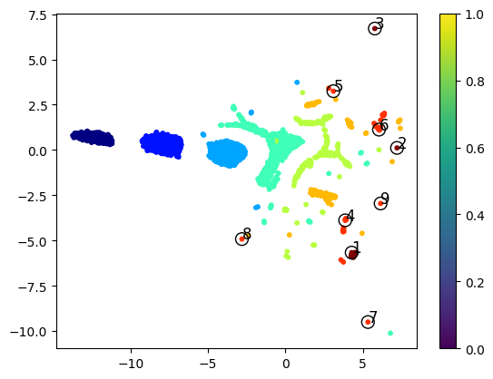
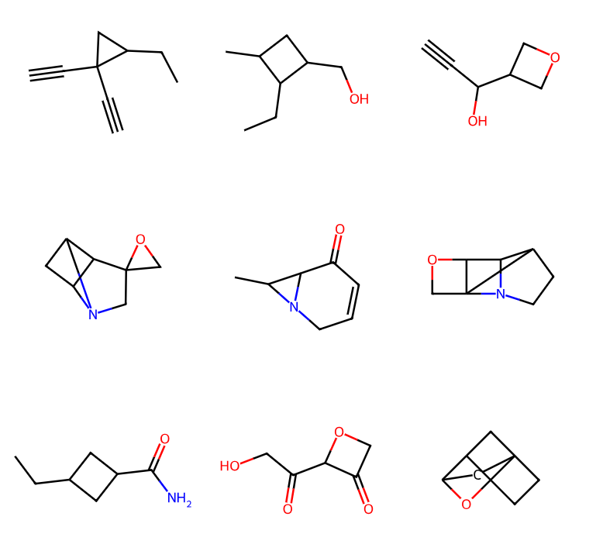
Molecular spaces
Geometric space
Chemical space
What is the dimensionality of the parameter space?
Is it differentiable?
What is the function?
Is it continuous?
Is it differentiable

Slide 12
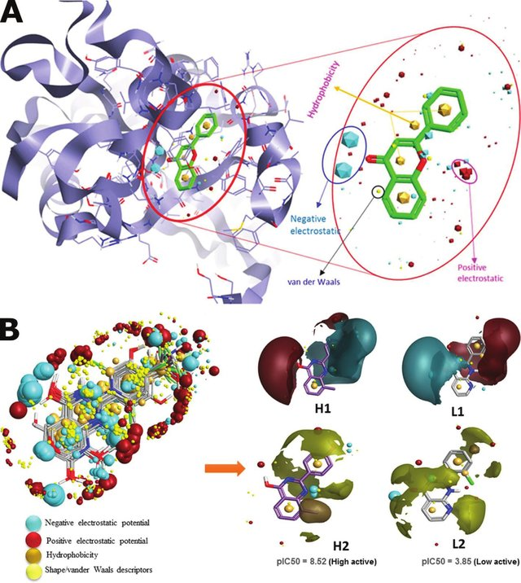
Structure–property relationships
What is the dimensionality of the parameter space?
Is it differentiable?
What is the function?
Is it continuous?
Is it differentiable
Hint: activity cliffs in quantitative structure-activity relations (QSAR)
https://www.researchgate.net/publication/342718908_Artificial_Intelligence_and_Machine_Learning_in_Computational_Nanotoxicology_Unlocking_and_Empowering_Nanomedicine/figures?lo=1

Slide 13
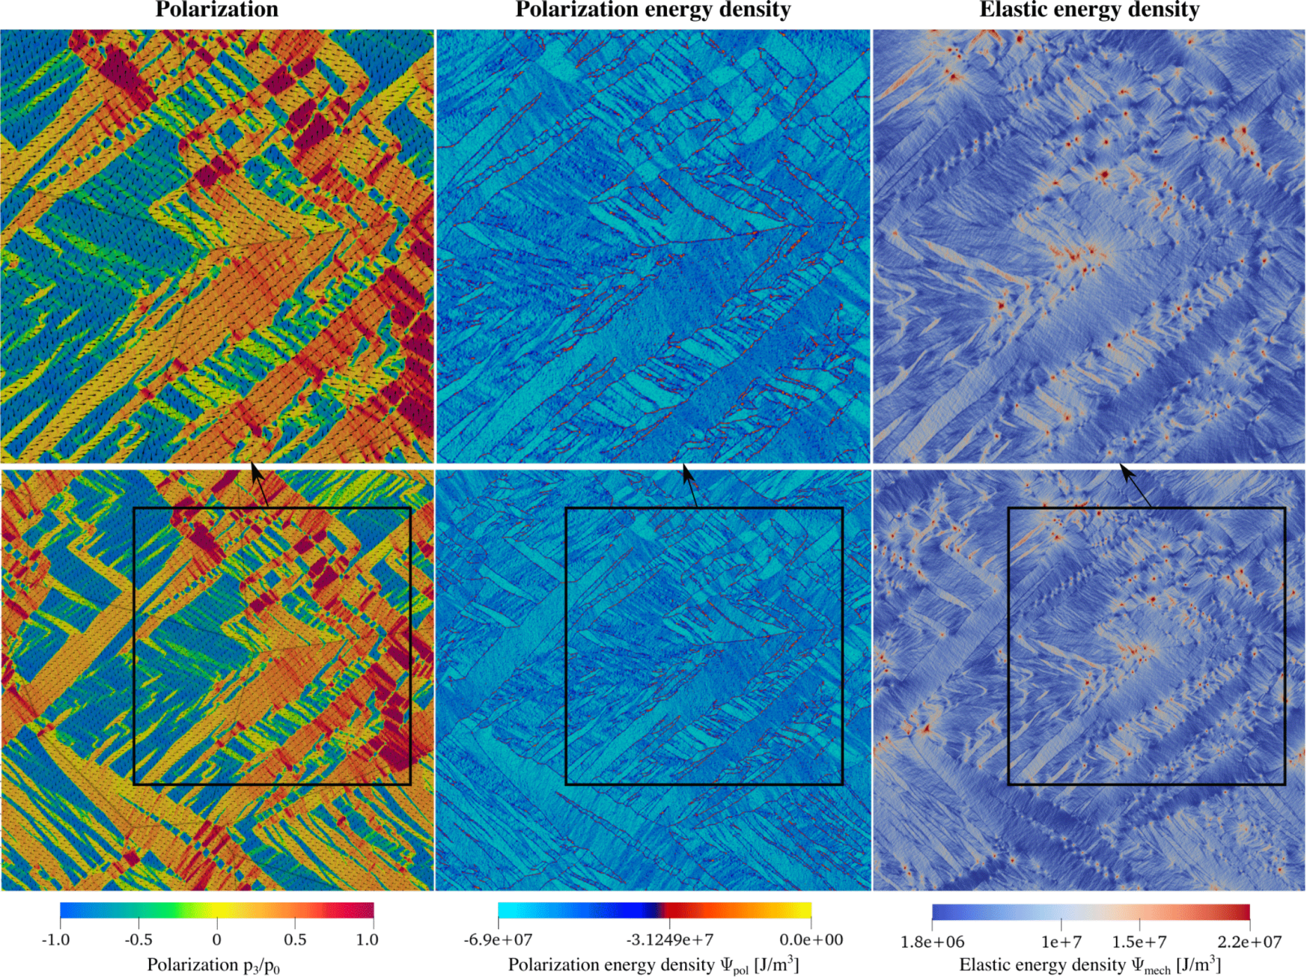
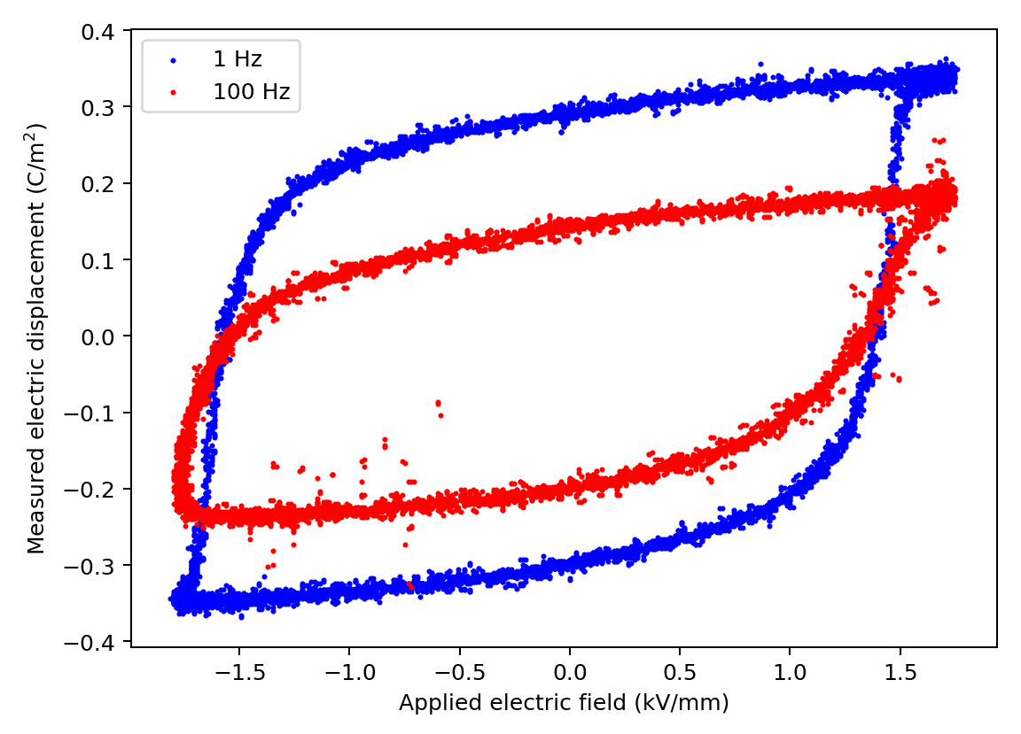
Structure–property relationships
What is the dimensionality of the parameter space?
Is it differentiable?
What is the function?
Is it continuous?
Is it differentiable

Slide 14
For each of these scenarios
Can we interpolate?
Can we differentiate?
Can we integrate?
Phase diagram
Process trajectories
QASR
Hysteresis loops

Slide 15
Off to Colab!

